Slide 1


DEEP LEARNING BASED AGENTS MODELING TO EXPLAIN MARKET STABILITY
Ministry Of Higher Education And Scientific Reseaarch
Sousse University
Superior Institution Of Applied Science And Technology
Master Thesis
Realised by: Achref Mtir
supervised by: dr. Dalel kanzari, issat sousse

Slide 2
Plan
General introduction: problematic & objectives
Existent solutions and state of the art
Proposed method and solution
Implementations and tests
Conclusion and perspective

Slide 3
General introduction: problematic & objectives
Problematic
Stock markets complexity and quick price variation.
The price change is hard to predict.
Every once in a while the stock falls into a crisis.
Large spectrum of parameters that plays a role in price variation.
Notes:
pendamics, social media, and news affects on the stock price, a lot of other variables such as the actions taken by investors like buying, holding, selling plays a huge role on the market stability.
when we say market stability we mean that the price of an asset is reasonably stable .
A stock market crash is a sudden dramatic decline of stock prices.

Slide 4
General introduction: problematic & objectives
Objectives
Using machine learning tools to predict stock market variation.
Explain the price variation according to investors behaviour.
Focus on finding and explaining of the stock market crash.
Notes:
by using machine learning algorithms and multi agent systems we will try to predict the stock price variation and simulate market trading to find the real combination of the stock market.

Slide 5



Existent solutions and state of the art
There is a plenty of realised work in the field of predicting stock markets and studying the price variation.
1- A Bat-Neural Network Multi-Agent System For Stock Price Prediction:
In this research the authors gathered statistics, news and historical price data.

Slide 6

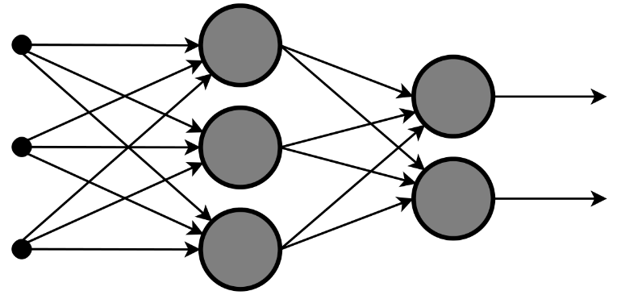
Existent solutions and state of the art
The study focuses on the features selection using a voting node.
Based on the features selected they created an artificial intelligence framework for predicting future price.

Slide 7
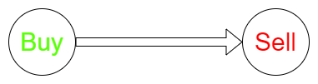
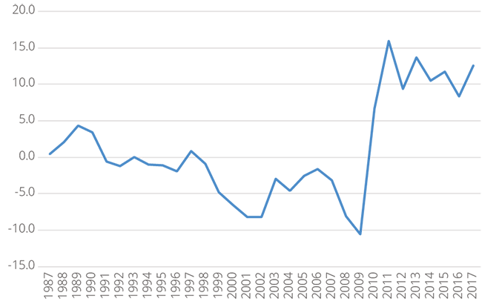
Existent solutions and state of the art
2- An Intelligent Agent-Based Stock Prediction System:
Two cases were studied in this study, the long term trend prediction which focuses on the change pattern between a buy and a sell points, to predict where the stock market is headed.
the short term trend prediction which
focuses on the daily changes of
the stock prices (open,high,low,close).

Slide 8

Existent solutions and state of the art
None of the above studies took into consideration the behaviour of traders and the nature of their reasoning.
In our study we will try to explain the real combination of stock markets and main behaviour that leads to a crash.
Rational Emotional Memetic

Slide 9

Proposed method and solution
We propose a stock market simulator that is capable of predicting future asset price and simulate a trading phase to explain the real stock market combination and the main responsible behaviour for market crash.
Notes:
Our multiagent system is capable of predicting any asset future price but we will be focusing on bitcoin.

Slide 10
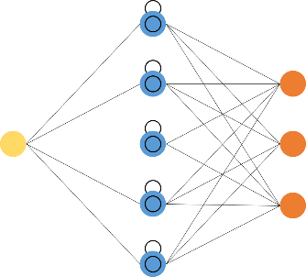


Proposed method and solution
MAS TRADING ENVIRONMENT
LSTM
Notes:
to do this we will be using multiagent systems equipped with LSTM neural networks in a trading environement.

Slide 11
Proposed method and solution
Why MAS ?
Why LSTM ?
Notes:
we use multi agent systems because we want to simulate traders by agents that interacts with an environment and take actions to reach a goal, similar to what a human being is acting like.
we choose LONG SHORT TERM MEMORY NETWORKS, it is used in time series data learning because it contains a memory that remembers the inputs over a long period of time and decides to store or delete information.

Slide 12



Proposed method and solution
Emotional Agent Rational Agent Memetic Agent
Notes:
by emotional agent we simulate an intermediate experienced trader that goes by emotions and has a variable confidence level, this affects the action taken in the marketplace.
a rational agent is a well experienced trader that bilieve only in true data and math, there is no emotions taking place in the decision making.
finally a memetic agent is a beginner in the trading field he tries to memic the most frequent action taken by other traders to make his decision.

Slide 13
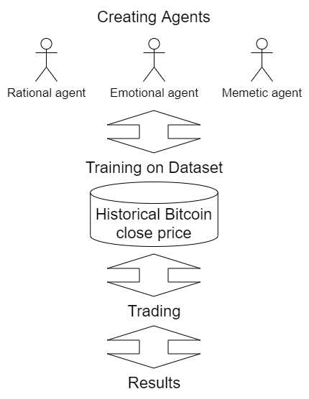
Proposed method and solution
Overall design

Slide 14
Implementations and tests
The configuration of the agents core varies between different agent type.
Rational agent Emotional agent Memetic agent
Notes:
building the agents is a challenge where every type has different core concept.
The rational agent will be giving a prediction based on the last 60 days of historical price and it will be taking the decision (buy, hold, sell) based on a constent threshold.
The emotional agent will be giving a prediction based on the last 40 days of historical price and it has a confidence level variable that will let it go out of boundaries (the threshold) when taking action.
The memetic agent will be giving a prediction based on the last 20 days of historical price data and it will be taking action based on its most frequent action module.

Slide 15
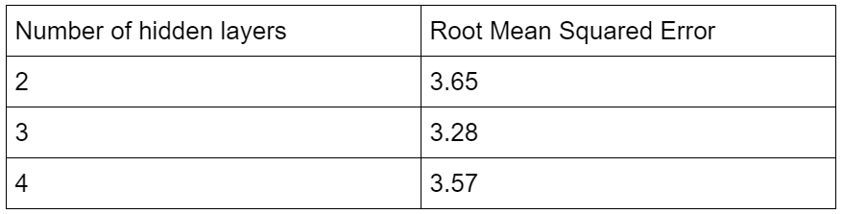
Implementations and tests
Finding the most accurate neural network structure.
Notes:
we tried different structures regarding the accuracy of the model.

Slide 16
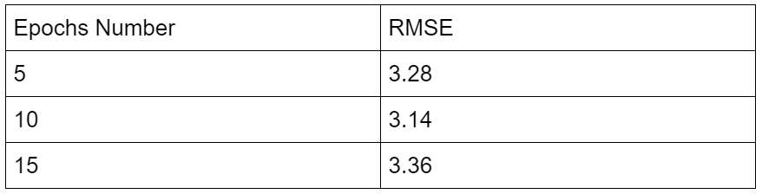
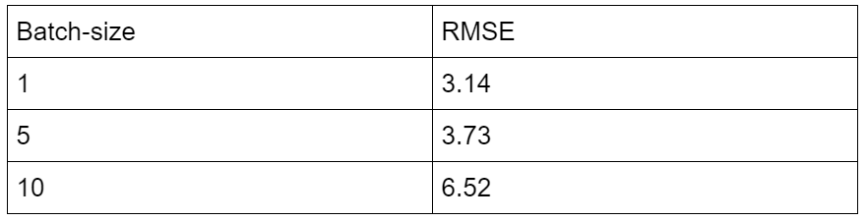
Implementations and tests
Determining the training parameters values.

Slide 17

Implementations and tests
Building the environment from scratch.
Stock Market Simulator
Notes:
There is some machine learning stock oriented environements to simulate agents trading like open AI GYM but it doesn’t meet our requirements and it is poorly documented, so it is a struggle trying to tweak it to do the job so we decided to create our own system using MAS tools and python programming language.

Slide 18
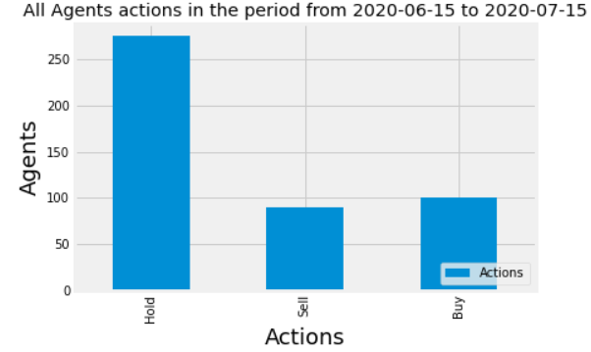
Implementations and tests
The results:
Notes:
The simulator was able to meet accuratly the reality of trading in a stable period, where there is a balance in actions taken by agents in this scenario.

Slide 19
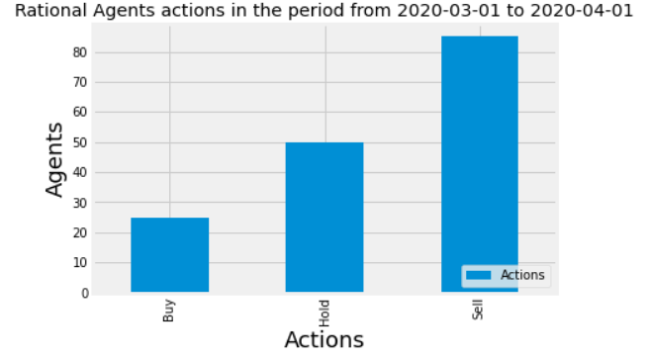
Implementations and tests
Notes:
During the covid-19 pendamic the simulator has proven potential where it predicted the stock crash, and we can see that in the high selling action compared to the buying due to the fast drop of price.

Slide 20
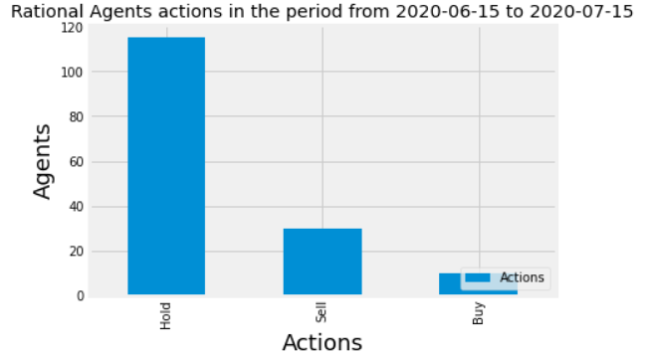
Implementations and tests
The Rational behaviour:
Rational agents actions during a stable period
Rational agents actions during a crisis period
Notes:
We can see a normal behaviour where there is multiple decisions took during the two periods.

Slide 21
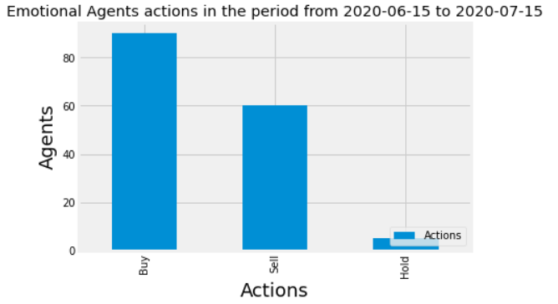
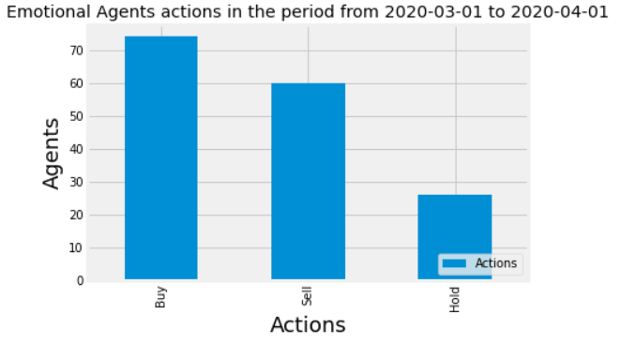
Implementations and tests
The Emotional behaviour:
Emotional agents actions during a stable period
Emotional agents actions during a crisis period
Notes:
The same thing can be said about the emotional behaviour where it is a mixture of actions taken during the two periods.

Slide 22
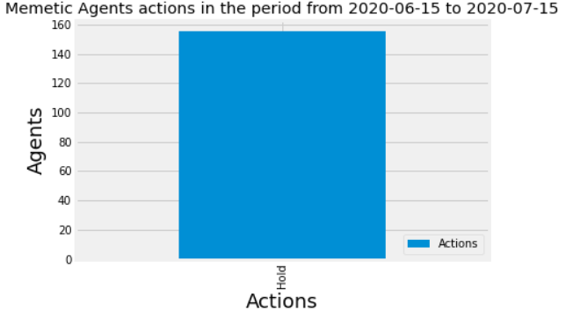
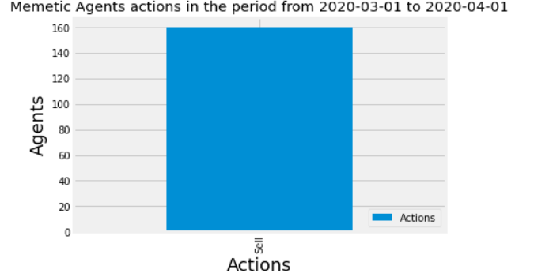
Implementations and tests
Memetic agents actions during a stable period
Memetic agents actions during a crisis period
Notes:
We see that the memetic agent is the responsible for the fast orientation of the trading where it is clearly taking the most frequent action during that time. So this leads to the fast shifting of price. Given a crisis period it surely can speedup the process of a market crash.

Slide 23

Implementations and tests
We want to further answer the question:
What is the real combination of the stock market traders behaviour ?
Notes:
To do so we will be using some finance technique and in depth research in data.

Slide 24
Implementations and tests
We will be simulating four scenarios, and by calculating the mean absolute error we will decide the closest to reality market combination.

Slide 25
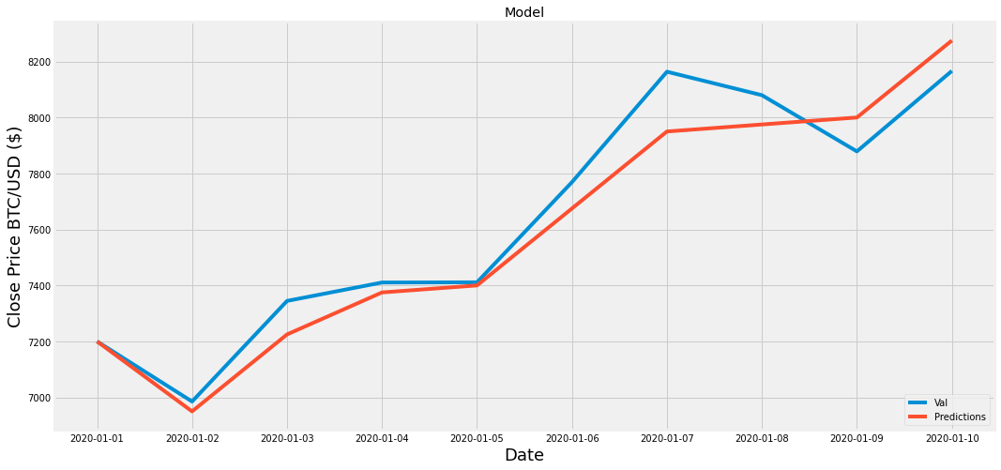
Implementations and tests
- Scenario 1:
33.5% rational agents, 33.5% emotional agents, 33.5% mimetic agents.
MAE = 84,36 %
Notes:
The error explains the ressemblance between real values and predicted values.

Slide 26
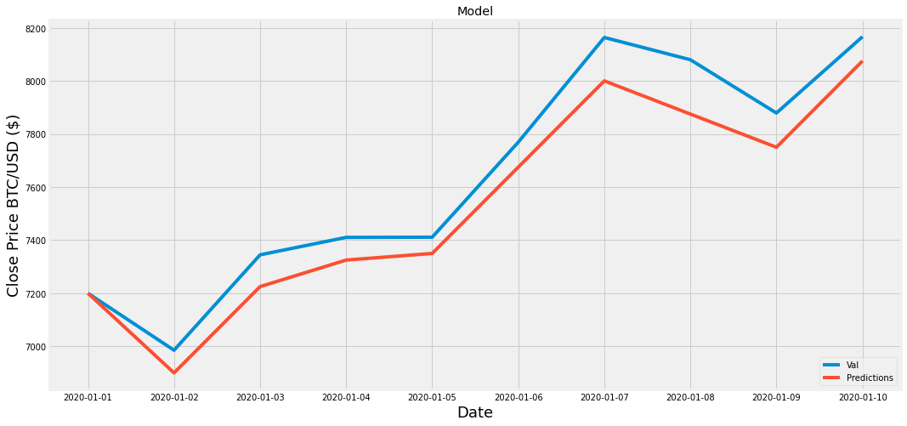
Implementations and tests
- Scenario 2:
60% rational agents, 20% emotional agents, 20% mimetic agents.
MAE = 103,41%

Slide 27
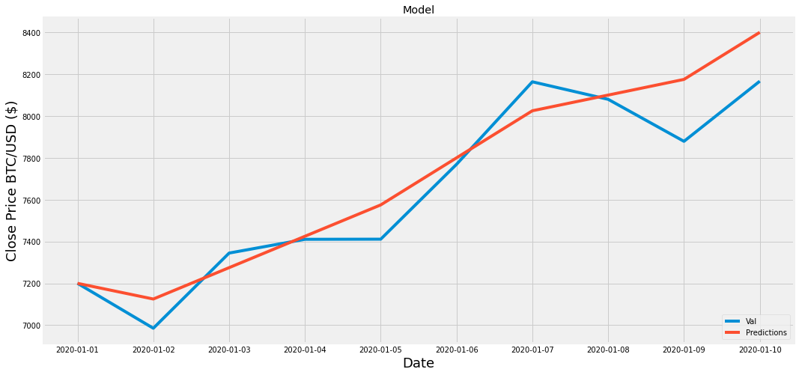
Implementations and tests
- Scenario 3:
20% rational agents, 60% emotional agents, 20% mimetic agents.
MAE = 110,73 %

Slide 28
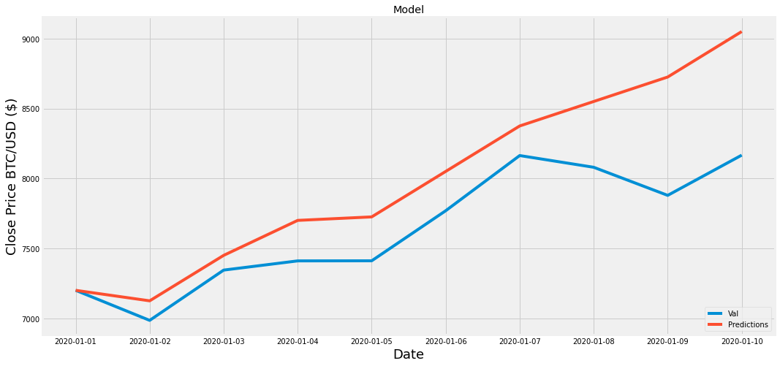
Implementations and tests
- Scenario 4:
20% rational agents, 20% emotional agents, 60% mimetic agents.
MAE = 354,08 %

Slide 29
Implementations and tests
The lowest MAE value is in the first scenario where there is an equal amount of behaviours, meaning that the marketplace is combination of all three behaviours.

Slide 30
Conclusion and perspective
We managed to use machine learning techniques and multiagent systems to create a stock market simulator that is capable of both predicting and decision help.
We are the first to integrate the behaviour of traders in such a system and we are proud of this contribution.
This can be used in real life scenarios to help traders in achieving their goals.
It wasn’t an easy task, but also there is room for improvement for future work.

Slide 31
Conclusion and perspective
For future work:
we want to see a more accurate predictions.
We can give agents wallets and capital and let it trade for a period of time, finally find the profits made by agents to know which behavior is the best and in what circumstances.

Slide 32
Thanks for your attention

